Slide 1
DATABASE Management SYSYEMs
Introduction to

Slide 2
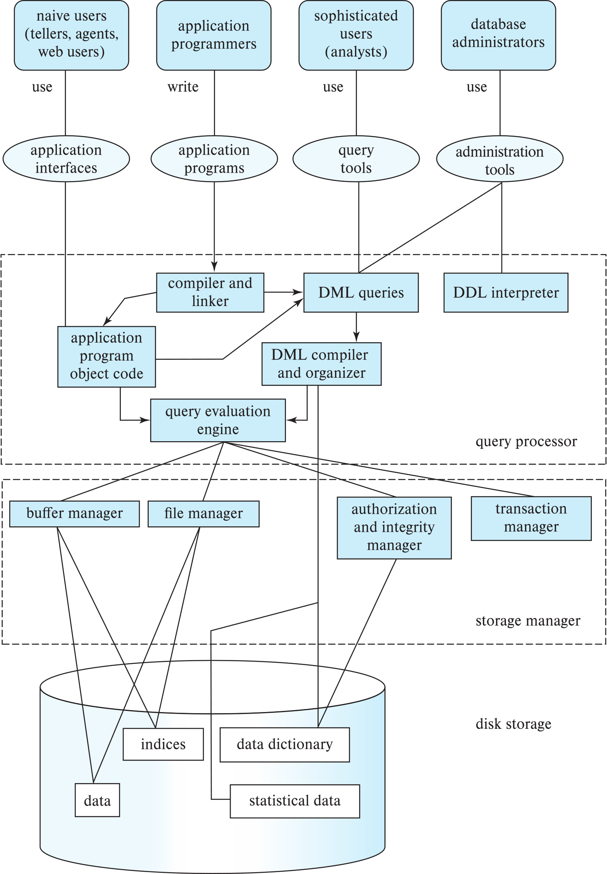
Database Users
Notes:
2

Slide 4
Database Administrator
A person who has central control over the system is called a database administrator (DBA). Functions of a DBA include:
Schema definition
Storage structure and access-method definition
Schema and physical-organization modification
Granting of authorization for data access
Routine maintenance
Periodically backing up the database
Ensuring that enough free disk space is available for normal operations, and upgrading disk space as required
Monitoring jobs running on the database
Notes:
4

Slide 5
Database Architecture
Centralized databases
One to a few cores, shared memory
Client-server,
One server machine executes work on behalf of multiple client machines.
Parallel databases
Many core shared memory
Shared disk
Shared nothing
Distributed databases
Geographical distribution
Schema/data heterogeneity
Notes:
5

Slide 6
Database Applications
Database applications are usually partitioned into two or three parts
Two-tier architecture -- the application resides at the client machine, where it invokes database system functionality at the server machine
Three-tier architecture -- the client machine acts as a front end and does not contain any direct database calls.
The client end communicates with an application server, usually through a forms interface.
The application server in turn communicates with a database system to access data.
Notes:
6

Slide 7
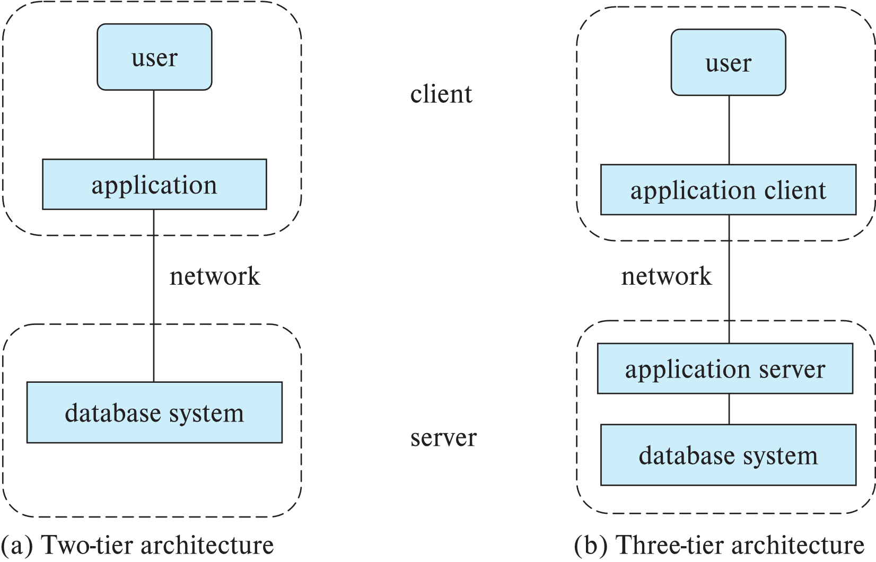
Two-tier and three-tier architectures
Notes:
7

Slide 8
End of Chapter 1
Notes:
8

